Slide 1
Vector space model Vs . Language Model
IR systems
By: Raghad Ramazan

Slide 2
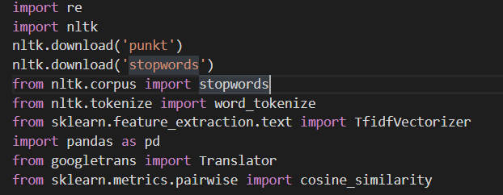
Vector space model

Slide 3
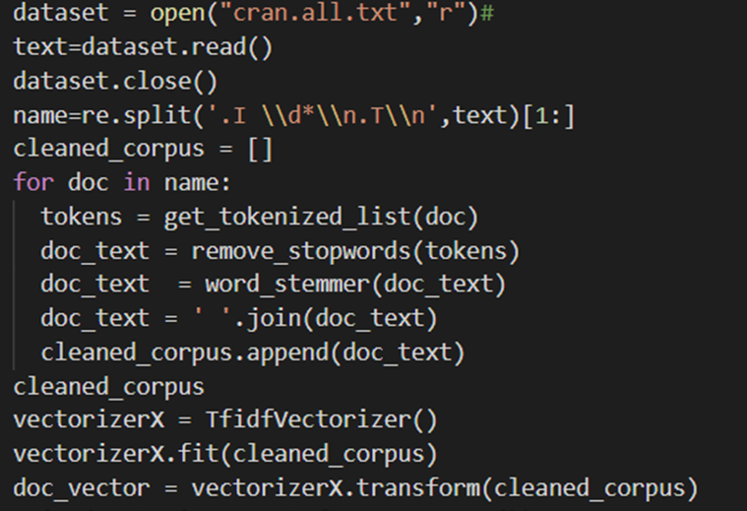

Slide 4
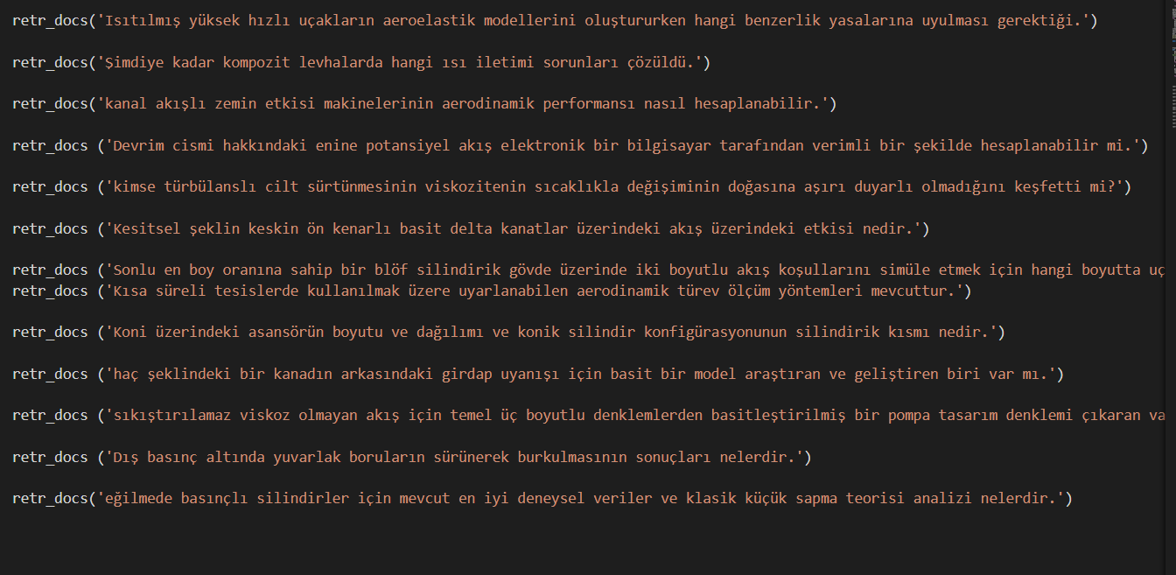

Slide 5
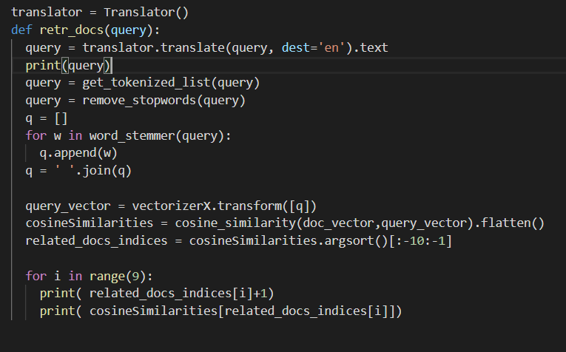

Slide 6
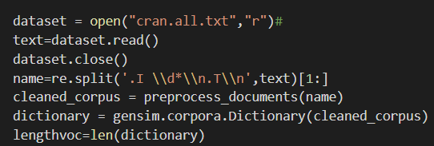
Language Model

Slide 7




Slide 8




Slide 9


Slide 10
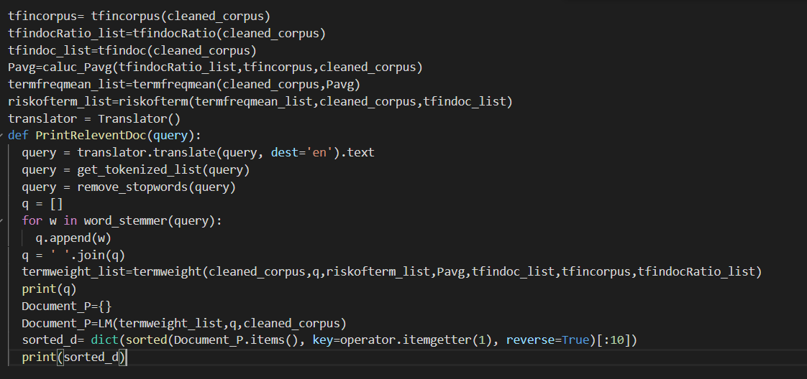

Slide 11
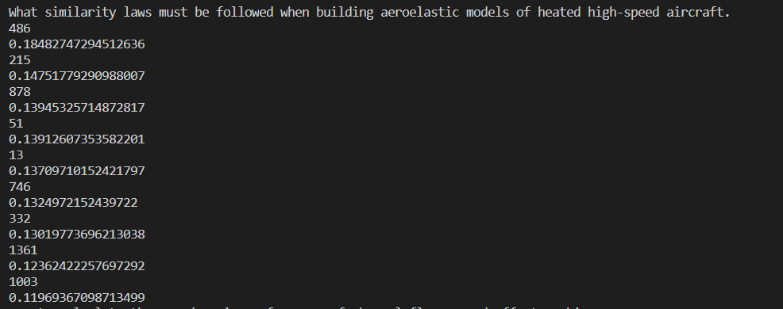
Recall in VSM for this query was :0.33
And precision : 0.103448275862069
Recall in Model language for this query was :0.2
And precision : 0.06896

Slide 12


